Slide 1


CARLA
Eric
Sree
Linbo

Slide 2

Model Used
RESNET 50 & DETR

Slide 3
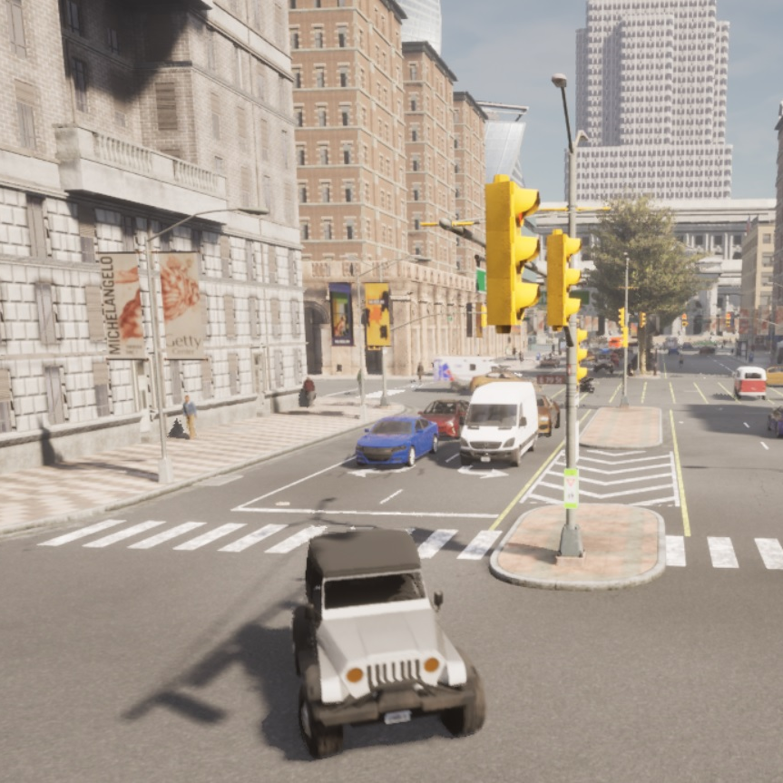
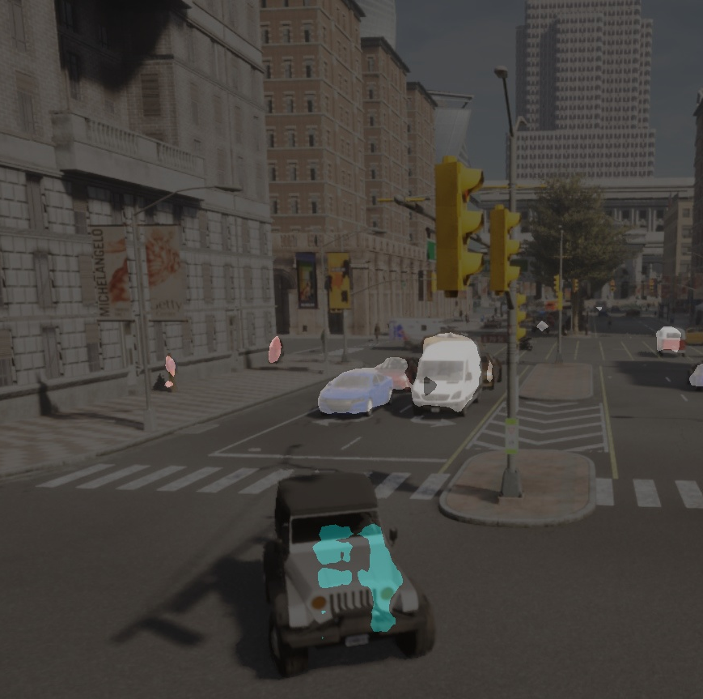
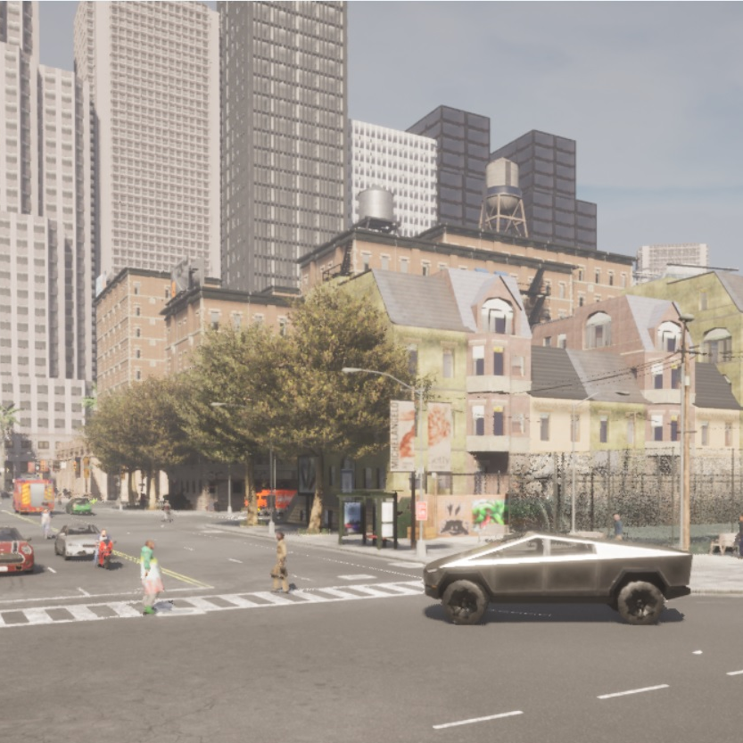
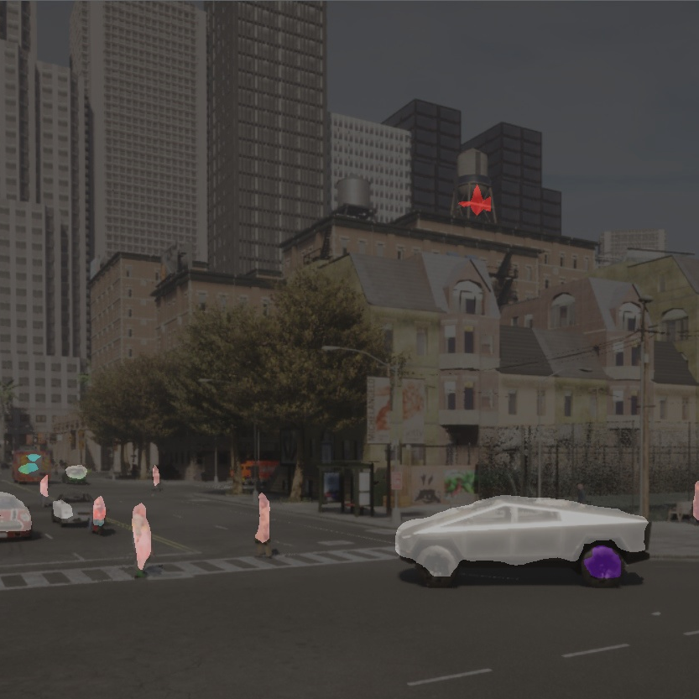
ReSNET Performance

Slide 4
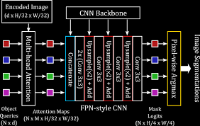
IMPROVEMENTS
DETR

Slide 5
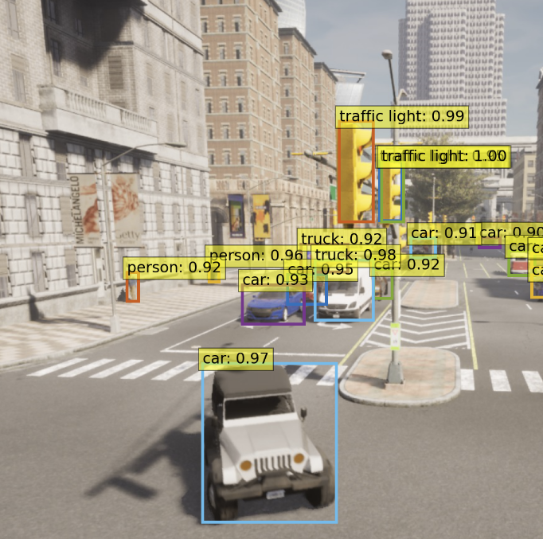
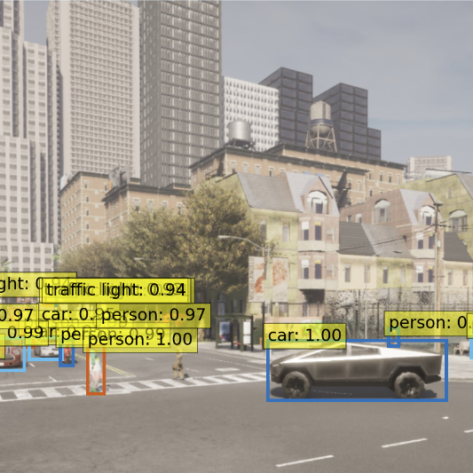
DETR Performance

Slide 6
THAnk YOU

